Slide 1
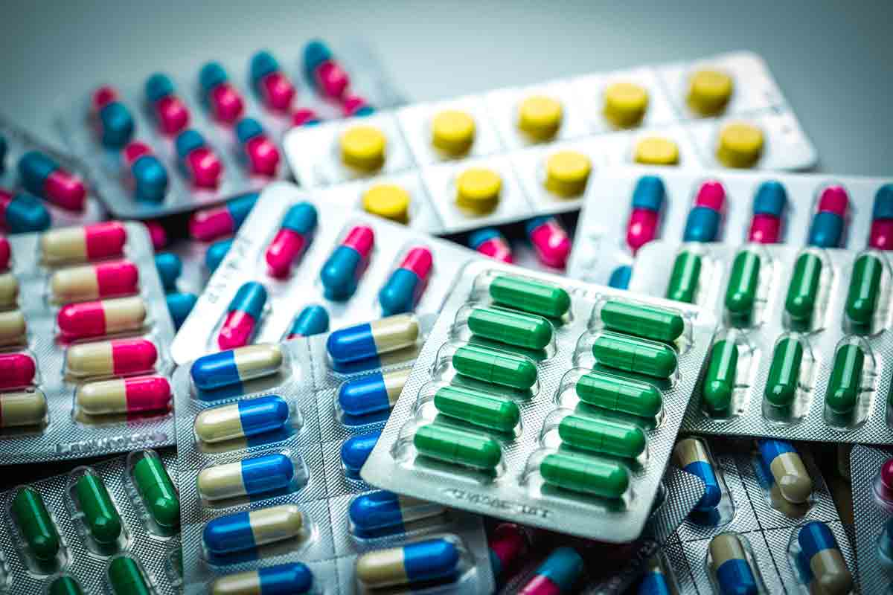
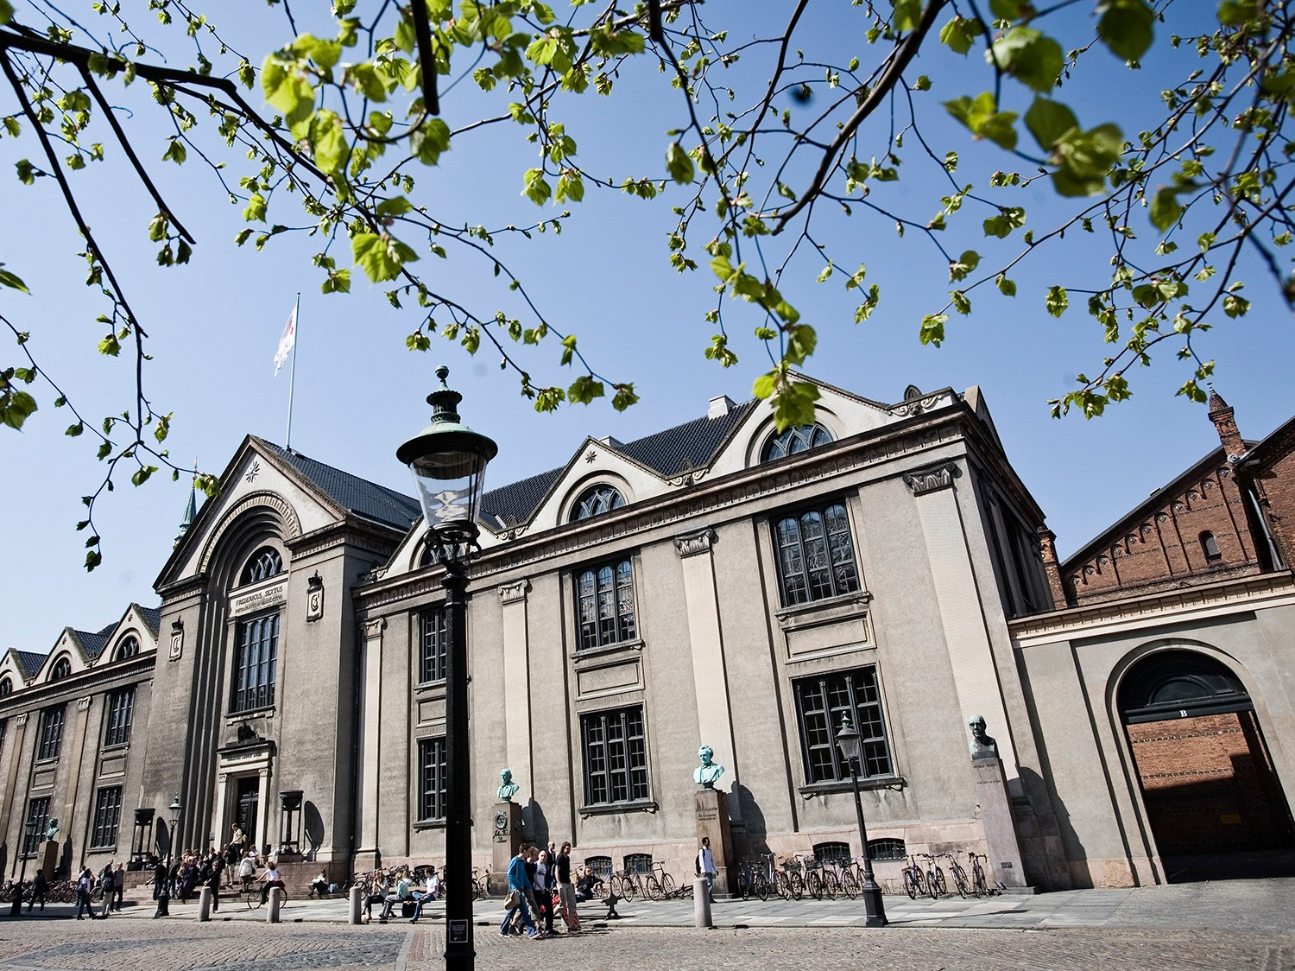
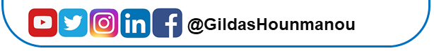
Antimicrobials and resistance genes
Gildas Hounmanou, PhD
APTI-Fellow, National Institutes of Health, MD, USA
Assistant-Professor
https://orcid.org/0000-0003-3991-0864
University of Copenhagen
Faculty of Health and Medical Sciences

Slide 2
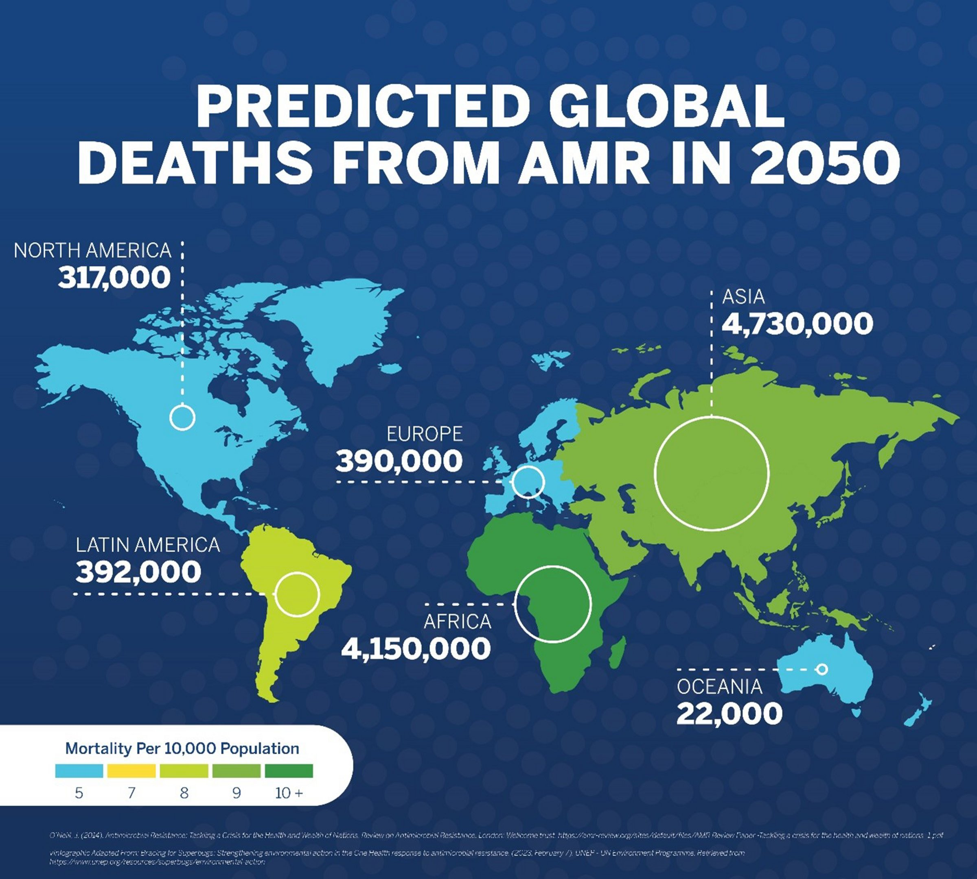
AMR in LMICs
BY
Antimicrobial resistance is a global threat at the intersection of human, animal, and environmental health
Genomics is revolutionizing our understanding of AMR, but much of its promise remains out of reach in LMICs, where the AMR burden is greatest
Genome sequencing is become more affordable and accessible
Continuous training on sequencing data analysis is therefore important to keep-up and equitably harness the promise of genomics to inform One Health AMR strategies in LMICs
https://www.thelancet.com/journals/lancet/article/PIIS0140-6736(21)02724-0/fulltext

Slide 3
What are antimicrobials and how are they classified
Substance that destroys or inhibits the growth of microorganisms and is used in the treatment of external or internal infections
While some antibiotics are produced by microorganisms, most are now manufactured synthetically
Classification of antibiotics
On the basis of mechanism of action
On the basis of spectrum of activity
On the basis of mode of action

Slide 4
On the basis of mechanism of action
Cell Wall Synthesis inhibitors
Penicillins
Cephalosporins
Vancomycin
Beta-lactamase Inhibitors
Polymycin
Bacitracin
Protein Synthesis Inhibitors
Inhibit 30s Subunit
Aminoglycosides (gentamycin)
Tetracyclines
Inhibit 50s Subunit
Macrolides
Chloramphenicol
Clindamycin
Streptogramins
DNA Synthesis Inhibitors
Fluoroquinolones (ciprofloxacillin)
Metronidazole
RNA synthesis Inhibitors
Rifampin
Mycolic Acid synthesis inhibitors
Isoniazid
Folic Acid synthesis inhibitors
Sulfonamides
Trimethoprim

Slide 5
On the basis of mechanism of action

Slide 6
On the basis of spectrum of activity
· Broad spectrum antibiotics :
Amoxicillin
Tetracycline
cephalosporin
Chloramphenicol
Erythromycin
· Narrow/Short spectrum antibiotics:
Penicillin
Cloxacillin
vancomycin
Bacitracin
Fluxacillin

Slide 7
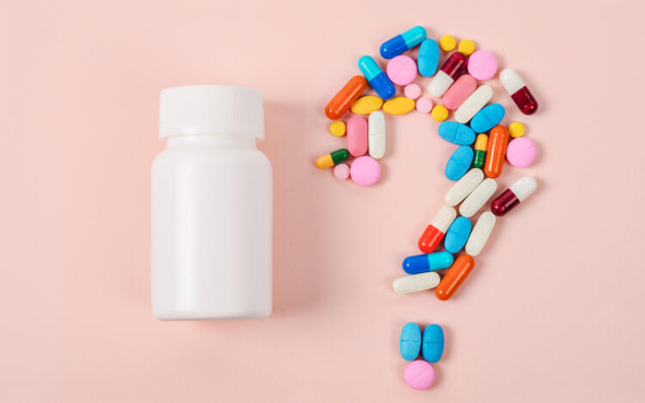
On the basis of mode of action
· Bacteriostatic antibiotics
Tetracycline
Chlorampenicol
Erythromycin
Lincomycin
· Bacteriocidal antibiotics
Cephalosporin
Penicillin
Erythromycin
Aminoglycosides
Cotrimoxazole

Slide 8
Antibiotics resistance
If the concentration of drug requires to inhibit or kill the microorganism is greater than normal use then the microorganism is considered to be resistant to the drug.
OR
The ability of a microorganism to produce a protein that disables an antibiotic or prevents transport of the antibiotic into the cell.

Slide 9
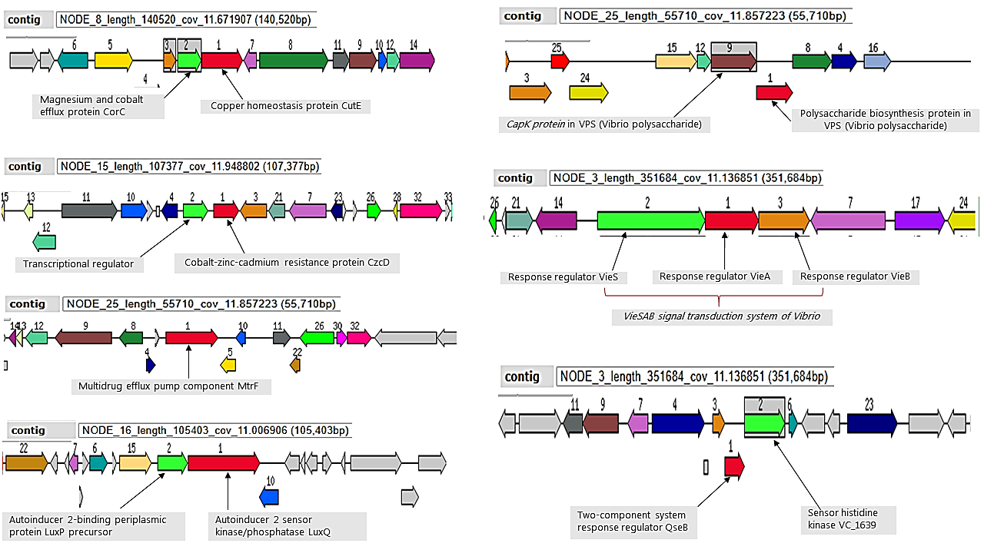
Selected Antimicrobial resistance genes and efflux pumps

Slide 10


Any Question is welcome
?
Gildas Hounmanou, PhD
APTI-Fellow, National Institutes of Health, MD, USA
Assistant-Professor
https://orcid.org/0000-0003-3991-0864
University of Copenhagen
Faculty of Health and Medical Sciences

